Slide 1
Face Recognition in Challenging Environments

Slide 2
List of Modules
Pose classifier
Face Frontalyzer
Face Recognition

Slide 3
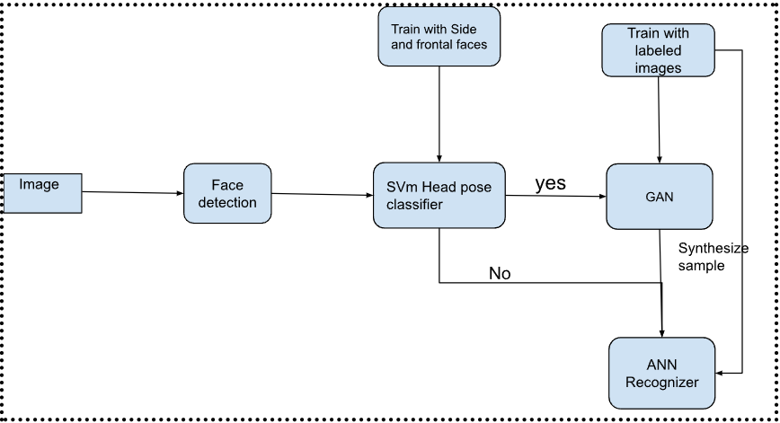
Proposed Architecture

Slide 4
Face detection
Methods:
→Blaze Face detector
→YOLOv8
→MTCNN
Name | Number of samples | threshold | Return detections | False detections | Blur faces | Accuracy | Time On CPU
Blaze Face | 50 | 0.6 | 53 | 1 | 3 | 98% | 0.8ms
YOLOv8 | 50 | 0.8 | 56 | 2 | 4 | 92% | 1-3 sec
MTCNN | 50 | 0.9 | 53 | 1 | 3 | 98% | 2-4s

Slide 5
Pose classifier
→SVM pose classifier
→Classify frontal faces and side faces
→Train with Multi-PIE dataset
Results:
Accuracy:97%
cross validation score:71%
FAR:0.02
FRR:0.02

Slide 6
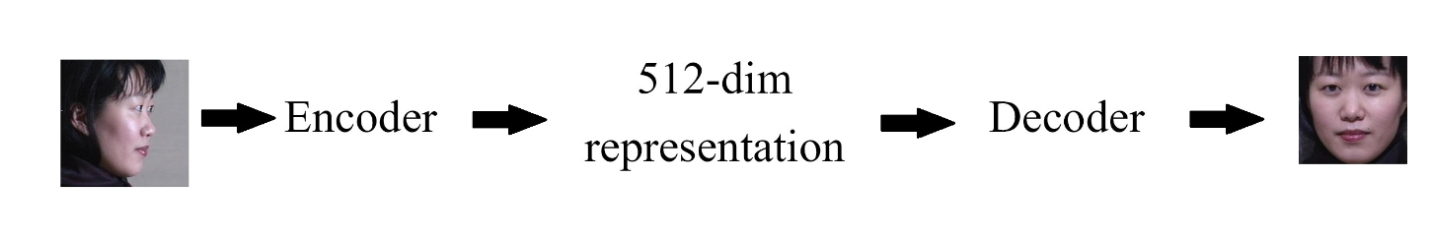
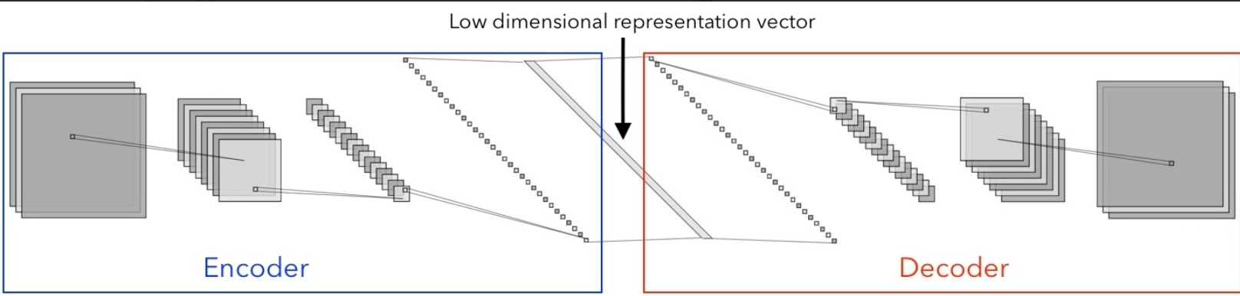
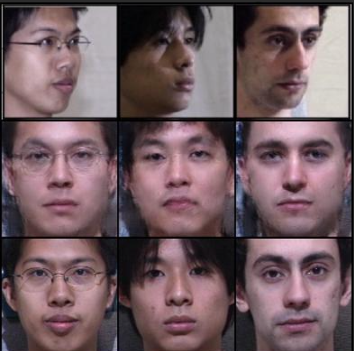
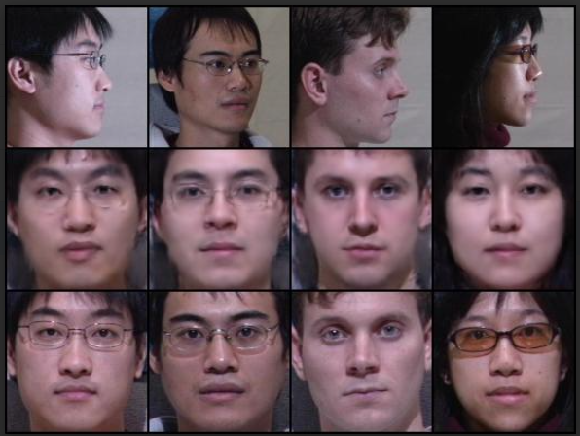
Face Frontalizer
→Generate synthesized frontal faces from side faces
→Pretrained model from scaleway github repo.it can be implemented by using style GAN.
→Finetuning with Multi-PIE dataset.

Slide 7
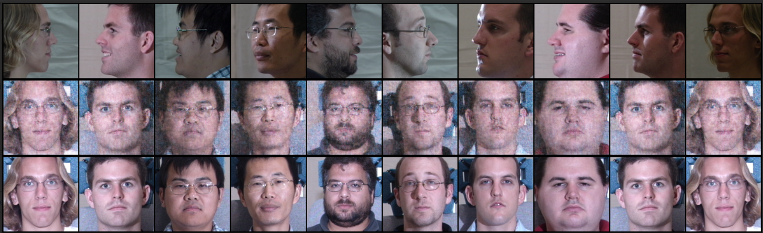
BCE loss
Results:

Slide 8
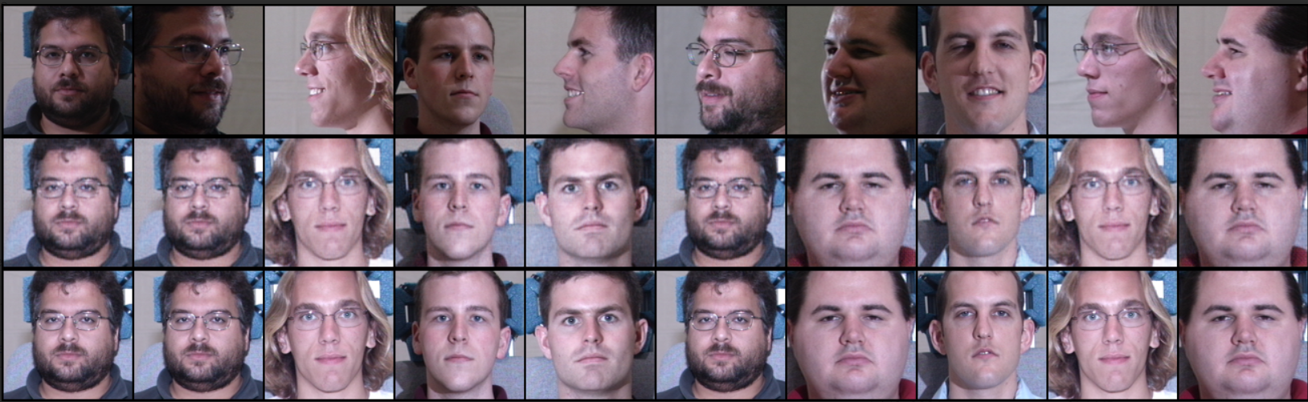
MSE
Results:

Slide 9
Face Recognition using ML

Slide 10
Feature Extraction
FaceNet:
FaceNet Feature extraction
Feature vector 512 embeddings
FaceNet + Hog:
Combination of FaceNet + HOG features
Feature vector 1312
FaceNet + LBP:
Combination of FaceNet + LBP
Feature Vector 539

Slide 11
ML based face recognition
SVM classifier
Train on Multi-PIE dataset
Results:
Dataset :Multi-PIE Dataset :Indian-Celeb
Features | Score | Cross validation score | FAR | FRR
FaceNet | 99% | 99% | 0.00 | 0.01
FaceNet +Hog | 99% | 99% | 0.00 | 0.00
FaceNet + LBP | 99% | 98% | 0.00 | 0.01
Features | Score | Cross validation score | FAR | FRR
FaceNet+Hog | 88% | 91% | 0.50 | 1.00
FaceNet+LBP | 98% | 98% | 0.00 | 0.50

Slide 12
Face Recognition using CNN

Slide 13
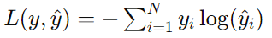
CNN based face recognition
Trained 3 models using 3 different loss functions
Categorical_crossentropy
Model summary
Total params: 12954206 (49.42 MB)
Trainable params: 12954206 (49.42 MB)
Non-trainable params: 0 (0.00 Byte)
Accuracy:99%
FAR:0.00
FRR:0.75

Slide 14
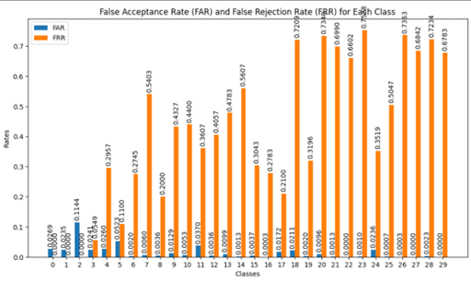
Softmax loss function
Dataset:Multi-PIE
Accuracy | FAR | FRR
99% | 0.00 | 0.75

Slide 15
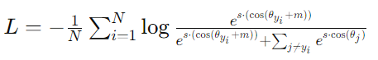
ArcFaceLoss function
Model summary
Total params: 12954176 (49.42 MB)
Trainable params: 12954176 (49.42 MB)
Non-trainable params: 0 (0.00 Byte)
Accuracy:100%
FAR:0.00
FRR:0.25

Slide 16
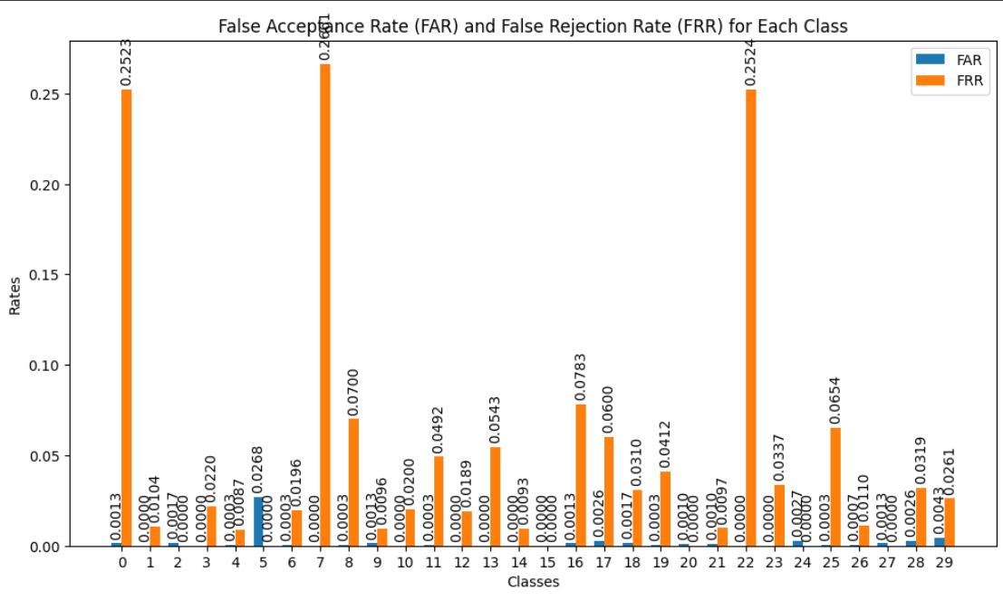
ArcFace loss function
Dataset: Multi-PIE
Accuracy | FAR | FRR
100% | 0.01 | 0.25

Slide 17
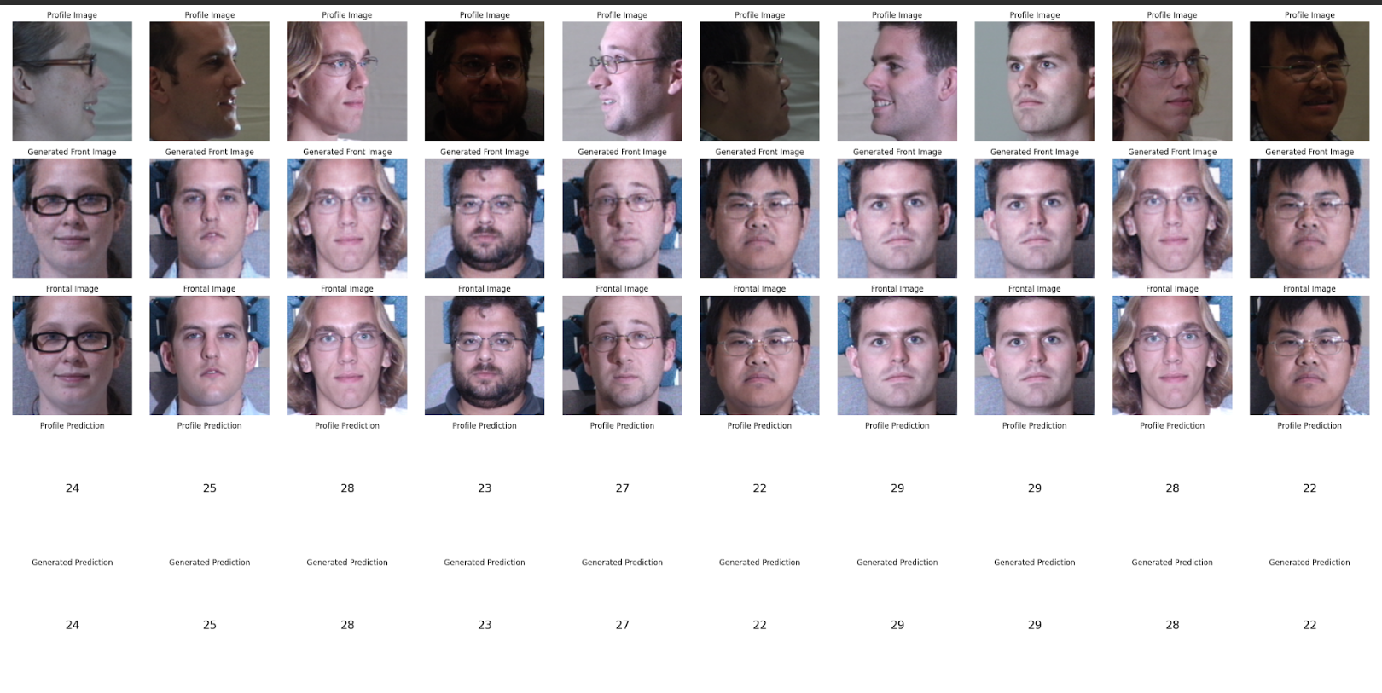
Final outcomes
Here we are using
→CNN face classifier model train with soft max loss function
→GAN model train with MSE function

Slide 18
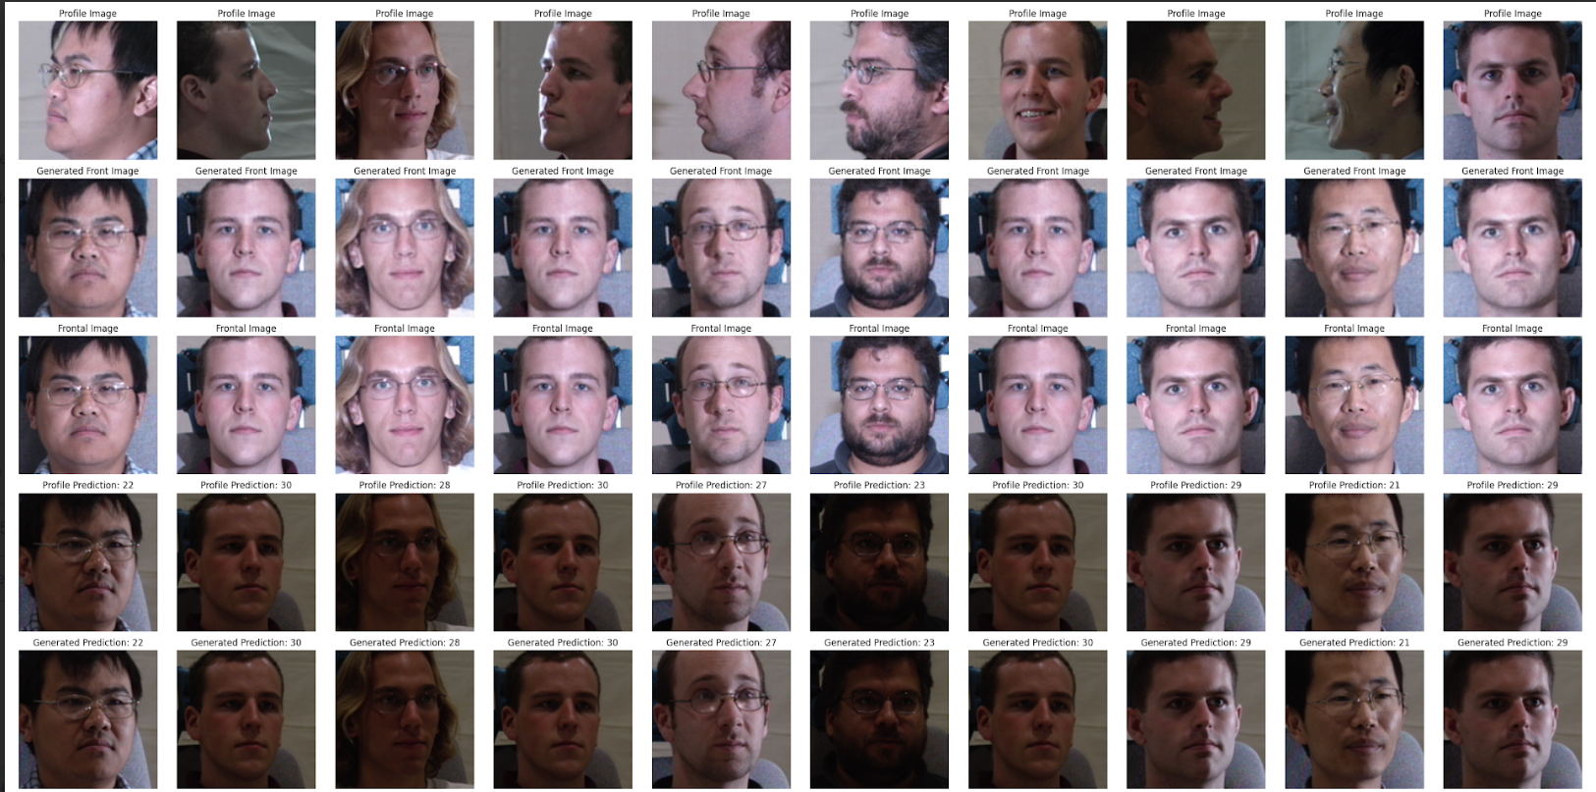
Final Results
Side faces →
generated Faces →
Real faces →
Side faces prediction →
Generated faces prediction →

